Slide 1


Principles of Information Security,
Fifth Edition
Chapter 5
Risk Management

Slide 2
Learning Objectives
Upon completion of this material, you should be able to:
  Define risk management, risk identification, and risk control
  Describe how risk is identified and assessed
  Assess risk based on probability of occurrence and likely impact
  Explain the fundamental aspects of documenting risk via the process of risk assessment
Principles of Information Security, Fifth Edition
Notes:
Learning Objectives
Upon completion of this chapter you should be able to:
Define risk management, risk identification, and risk control
Describe how risk is identified and assessed
Assess risk based on probability of occurrence and likely impact
Explain the fundamental aspects of documenting risk via the process of risk assessment

Slide 3
Learning Objectives (cont’d)‏
  Describe the various risk mitigation strategy options
  Identify the categories that can be used to classify controls
  Discuss conceptual frameworks for evaluating risk controls and formulate a cost-benefit analysis
Principles of Information Security, Fifth Edition
Notes:
Learning Objectives
Describe the various risk mitigation strategy options
Identify the categories that can be used to classify controls
Discuss conceptual frameworks for evaluating risk controls and formulate a cost benefit analysis

Slide 4
Introduction
Organizations must design and create safe environments in which business processes and procedures can function.
Risk management: the process of identifying, assessing, and reducing risks facing an organization
Risk identification: the enumeration and documentation of risks to an organization’s information assets
Risk control: the application of controls that reduce the risks to an organization’s assets to an acceptable level
Principles of Information Security, Fifth Edition
Notes:
Introduction
Organizations must design and create safe environments in which business processes and procedures can function
Risk management: process of identifying, assessing, and reducing risks facing an organization
Risk identification: enumeration and documentation of risks to organization’s information assets
Risk control: application of controls that reduce risks to an organization’s assets to an acceptable level

Slide 5
An Overview of Risk Management
Know yourself: identify, examine, and understand the information and systems currently in place
Know the enemy: identify, examine, and understand the threats facing the organization
Responsibility of each community of interest within an organization to manage the risks that are encountered
Principles of Information Security, Fifth Edition
Notes:
Know Ourselves
Know yourself: identify, examine, and understand the information and systems currently in place
Know the enemy: identify, examine, and understand threats facing the organization
Responsibility of each community of interest within an organization to manage risks that are encountered

Slide 6
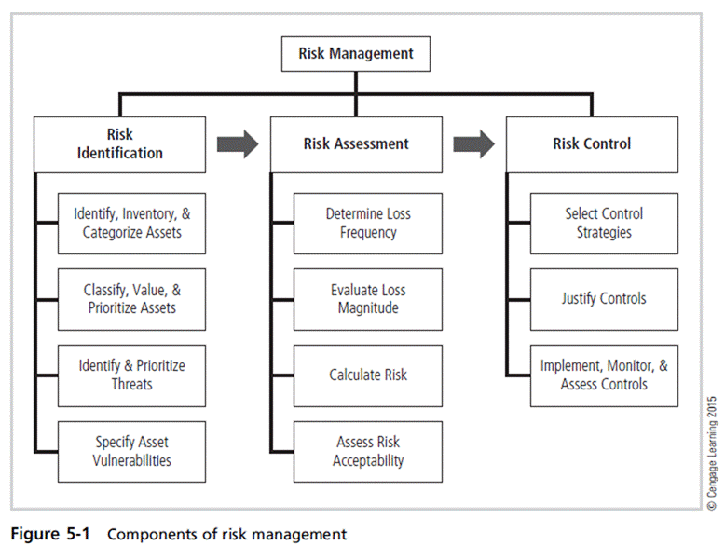
Principles of Information Security, Fifth Edition

Slide 7
The Roles of the Communities of Interest
Information security, management and users, and information technology all must work together.
Communities of interest are responsible for:
  Evaluating the risk controls
  Determining which control options are cost effective for the organization
  Acquiring or installing the needed controls
  Ensuring that the controls remain effective
Principles of Information Security, Fifth Edition
Notes:
Roles of Communities of Interest
Information security, management and users, and information technology all must work together
Communities of interest are responsible for:
Evaluating the risk controls
Determining which control options are cost effective for the organization
Acquiring or installing the needed controls
Ensuring that the controls remain effective

Slide 8
Risk Appetite and Residual Risk
Risk appetite: It defines the quantity and nature of risk that organizations are willing to accept as trade-offs between perfect security and unlimited accessibility.
  Reasoned approach is one that balances the expense of controlling vulnerabilities against possible losses if the vulnerabilities are exploited.
Residual risk: risk that has not been completely removed, shifted, or planned for
  The goal of information security is to bring residual risk into line with risk appetite.
Principles of Information Security, Fifth Edition

Slide 9
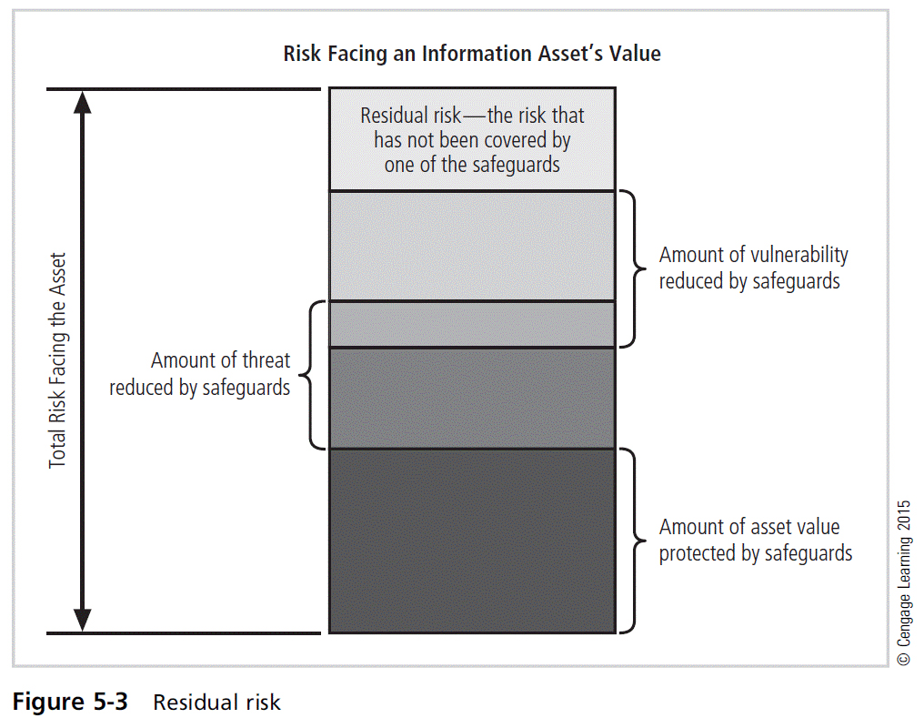
Principles of Information Security, Fifth Edition

Slide 10
Risk Identification
Risk management involves identifying, classifying, and prioritizing an organization’s assets.
A threat assessment process identifies and quantifies the risks facing each asset.
Principles of Information Security, Fifth Edition
Notes:
Risk Identification
Risk management involves identifying, classifying, and prioritizing an organization’s assets
A threat assessment process identifies and quantifies the risks facing each asset

Slide 11
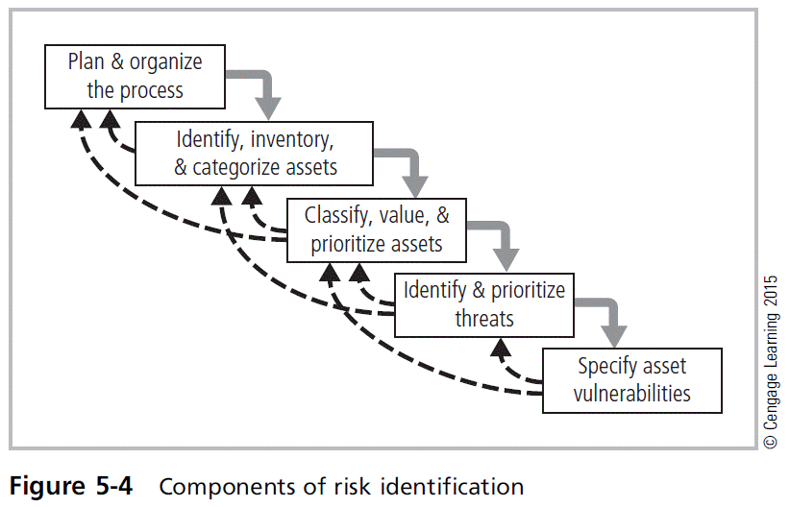
Principles of Information Security, Fifth Edition

Slide 12
Plan and Organize the Process
The first step in the risk identification process is to follow your project management principles.
Begin by organizing a team with representation across all affected groups.
The process must then be planned out.
  Periodic deliverables
  Reviews
  Presentations to management
Tasks laid out, assignments made, and timetables discussed
Principles of Information Security, Fifth Edition
Notes:
Plan/Organize the Process
First step in the Risk Identification process is to follow your project management principles
Begin by organizing a team with representation across all affected groups
The process must then be planned out
Periodic deliverables
Reviews
Presentations to management
Tasks laid out, assignments made and timetables discussed

Slide 13
Identifying, Inventorying, and Categorizing Assets
Iterative process: Begins with the identification and inventory of assets, including all elements of an organization’s system (people, procedures, data and information, software, hardware, networking)‏
Assets are then categorized.
Principles of Information Security, Fifth Edition
Notes:
Asset Identification and Valuation
This iterative process begins with the identification of assets, including all of the elements of an organization’s system: people, procedures, data and information, software, hardware, and networking elements.
Then, we classify and categorize the assets adding details as we dig deeper into the analysis.

Slide 14
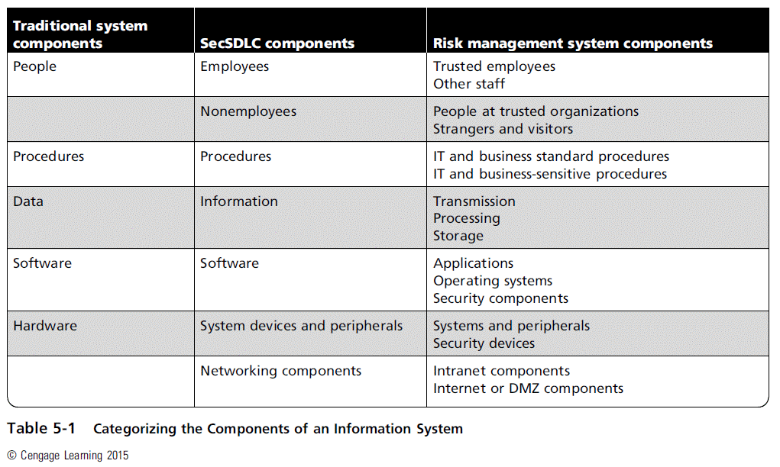
Principles of Information Security, Fifth Edition

Slide 15
People, Procedures, and Data Asset Identification
Human resources, documentation, and data information assets are more difficult to identify.
Important asset attributes:
  People: position name/number/ID; supervisor; security clearance level; special skills
  Procedures: description; intended purpose; relation to software/hardware/networking elements; storage location for reference; storage location for update
  Data: classification; owner/creator/manager; data structure size; data structure used; online/offline; location; backup procedures employed
Principles of Information Security, Fifth Edition
Notes:
People, Procedures, and Data Asset Identification
Human resources, documentation, and data information assets are more difficult to identify
Important asset attributes:
People: position name/number/ID; supervisor; security clearance level; special skills
Procedures: description; intended purpose; relation to software/hardware/networking elements; storage location for reference; storage location for update
Data: classification; owner/creator/manager; data structure size; data structure used; online/offline; location; backup procedures employed

Slide 16
Hardware, Software, and Network Asset Identification
What information attributes to track depends on:
  Needs of organization/risk management efforts
  Preferences/needs of the security and information technology communities
Asset attributes to be considered are name, IP address, MAC address, element type, serial number, manufacturer name, model/part number, software version, physical or logical location, and controlling entity.
Principles of Information Security, Fifth Edition
Notes:
Hardware, Software, and Network Asset Identification
Automated tools can sometimes uncover the system elements that make up the hardware, software, and network components.
Once created and stored, the inventory listing must be kept current, often through a tool that periodically refreshes the data.

Slide 17
Asset Inventory
Unless information assets are identified and inventoried, they cannot be effectively protected.
Inventory process involves formalizing the identification process in some form of organizational tool.
Automated tools can sometimes identify the system elements that make up hardware, software, and network components.
Principles of Information Security, Fifth Edition
Notes:
Asset Inventory
Unless information assets are identified and inventoried, cannot be effectively protected
Inventory process involves formalizing identification process in some form of organizational tool
Automated tools can sometimes identify system elements that make up hardware, software, and network components

Slide 18
Asset Categorization
People comprise employees and nonemployees.
Procedures either do not expose knowledge useful to a potential attacker or are sensitive and could allow adversary to gain advantage.
Data components account for the management of information in transmission, processing, and storage.
Software components are applications, operating systems, or security components.
Hardware: either the usual system devices and peripherals or part of information security control systems
Principles of Information Security, Fifth Edition
Notes:
Asset Categorization
People comprise employees and nonemployees
Procedures either do not expose knowledge useful to a potential attacker, or are sensitive and could allow adversary to gain advantage
Data components account for management of information in transmission, processing, and storage
Software components are applications, operating systems, or security components
Hardware either usual system devices and peripherals, or part of information security control systems

Slide 19
Classifying, Valuing, and Prioritizing Information Assets
Many organizations have data classification schemes (e.g., confidential, internal, public data)‏.
Classification of components must be specific enough to enable the determination of priority levels.
Categories must be comprehensive and mutually exclusive.
Principles of Information Security, Fifth Edition
Notes:
Information Asset Classification
Many organizations have data classification schemes (e.g., confidential, internal, public data)‏
Classification of components must be specific enough to enable determination of priority levels
Categories must be comprehensive and mutually exclusive

Slide 20
Data Classification and Management
Variety of classification schemes are used by corporate and military organizations.
Information owners are responsible for classifying their information assets.
Information classifications must be reviewed periodically.
Classifications include confidential, internal, and external.
Principles of Information Security, Fifth Edition
Notes:
Data Classification and Management
A variety of classification schemes are used by corporate and military organizations.
Information owners are responsible for classifying the information assets for which they are responsible.
At least once a year, information owners must review information classifications to ensure the information is still classified correctly and the appropriate access controls are in place.
The U.S. Military Classification Scheme has a more complex categorization system than required by most corporations. For most information, the military uses a five-level classification scheme: Unclassified, Sensitive But Unclassified (i.e., For Official Use Only), Confidential, Secret, and Top Secret.
Most organizations do not need the detailed level of classification used by the military or federal agencies. A simple scheme will allow the organization to protect its sensitive information, such as: Public, For official use only, Sensitive, Classified.

Slide 21
Data Classification and Management (cont’d)
Security clearances
  Each data user must be assigned authorization level indicating classification level.
  Before accessing specific set of data, the employee must meet the need-to-know requirement.
Management of classified data includes storage, distribution, transportation, and destruction.
Clean desk policy
Dumpster diving
Principles of Information Security, Fifth Edition
Notes:
Security Clearances
Security clearances
Each data user assigned authorization level indicating classification level
Before accessing specific set of data, employee must meet need-to-know requirement
Management of Classified Data includes storage, distribution, transportation, and destruction
Clean desk policy
Dumpster diving

Slide 22
Information Asset Valuation
Questions help develop criteria for asset valuation.
Which information asset:
  Is most critical to the organization’s success?
  Generates the most revenue/profitability?
  Plays the biggest role in generating revenue or delivering services?
  Would be the most expensive to replace or protect?
  Would be the most embarrassing or cause greatest liability if revealed?
Principles of Information Security, Fifth Edition
Notes:
Information Asset Valuation
Questions help develop criteria for asset valuation
Which information asset:
Is most critical to organization’s success?
Generates the most revenue/profitability?
Plays biggest role in generating revenue or delivering services?
Would be most expensive to replace or protect?
Would be the most embarrassing or cause greatest liability if revealed?

Slide 23
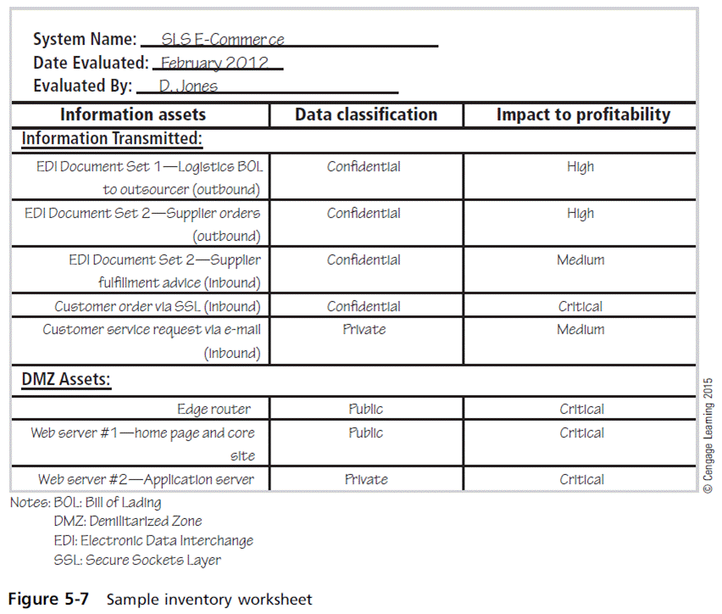
Principles of Information Security, Fifth Edition

Slide 24
Information Asset Valuation (cont’d)
Information asset prioritization
  Create weighting for each category based on the answers to questions.
  Prioritize each asset using weighted factor analysis.
  List the assets in order of importance using a weighted factor analysis worksheet.
Principles of Information Security, Fifth Edition
Notes:
Information Asset Valuation (cont’d.)
Information asset prioritization
Create weighting for each category based on the answers to questions
Prioritize each asset using weighted factor analysis
List the assets in order of importance using a weighted factor analysis worksheet

Slide 25
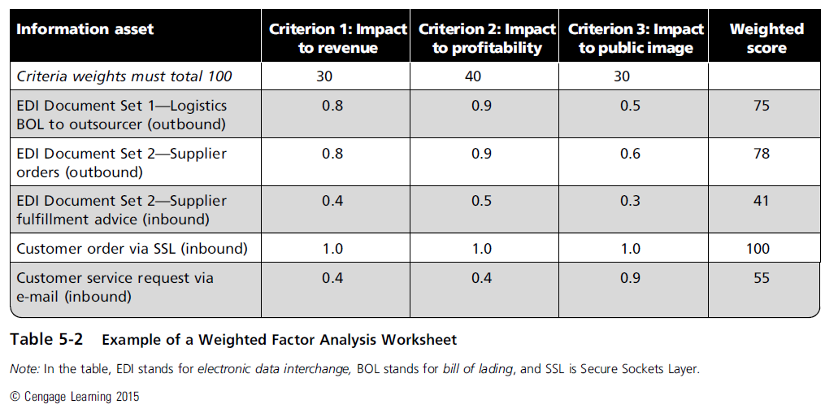
Principles of Information Security, Fifth Edition

Slide 26
Identifying and Prioritizing Threats
Realistic threats need investigation; unimportant threats are set aside.
Threat assessment:
  Which threats present danger to assets?
  Which threats represent the most danger to information?
  How much would it cost to recover from a successful attack?
  Which threat requires greatest expenditure to prevent?
Principles of Information Security, Fifth Edition
Notes:
Threat Identification
Each of these threats identified has the potential to attack any of the assets protected.
If we assume every threat can and will attack every information asset, this will quickly become more complex and overwhelm the ability to plan.
To make this part of the process manageable, each step in the threat identification and vulnerability identification process is managed separately and then coordinated at the end of the process.

Slide 27
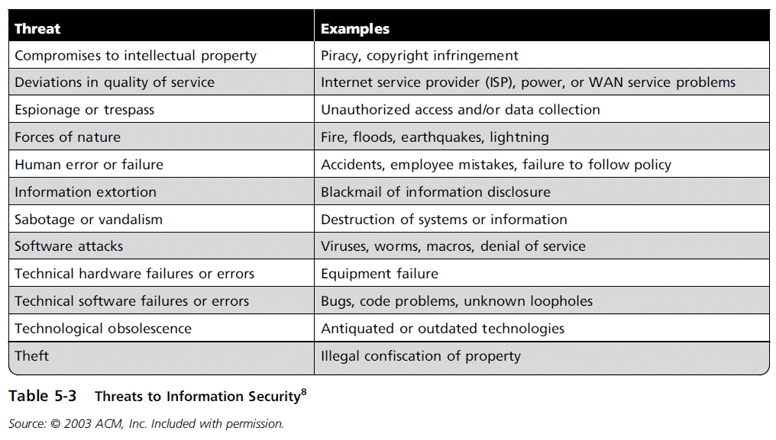
Principles of Information Security, Fifth Edition

Slide 28
Specifying Asset Vulnerabilities
Specific avenues threat agents can exploit to attack an information asset are called vulnerabilities.
Examine how each threat could be perpetrated and list the organization’s assets and vulnerabilities.
Process works best when people with diverse backgrounds within organization work iteratively in a series of brainstorming sessions.
At the end of the risk identification process, prioritized list of assets with their vulnerabilities is achieved.
  Can be combined with weighted list of threats to form threats-vulnerabilities-assets (TVA) worksheet
Principles of Information Security, Fifth Edition
Notes:
Vulnerability Identification
Specific avenues threat agents can exploit to attack an information asset are called vulnerabilities
Examine how each threat could be perpetrated and list organization’s assets and vulnerabilities
Process works best when people with diverse backgrounds within organization work iteratively in a series of brainstorming sessions
At end of risk identification process, prioritized list of assets with their vulnerabilities is achieved

Slide 29
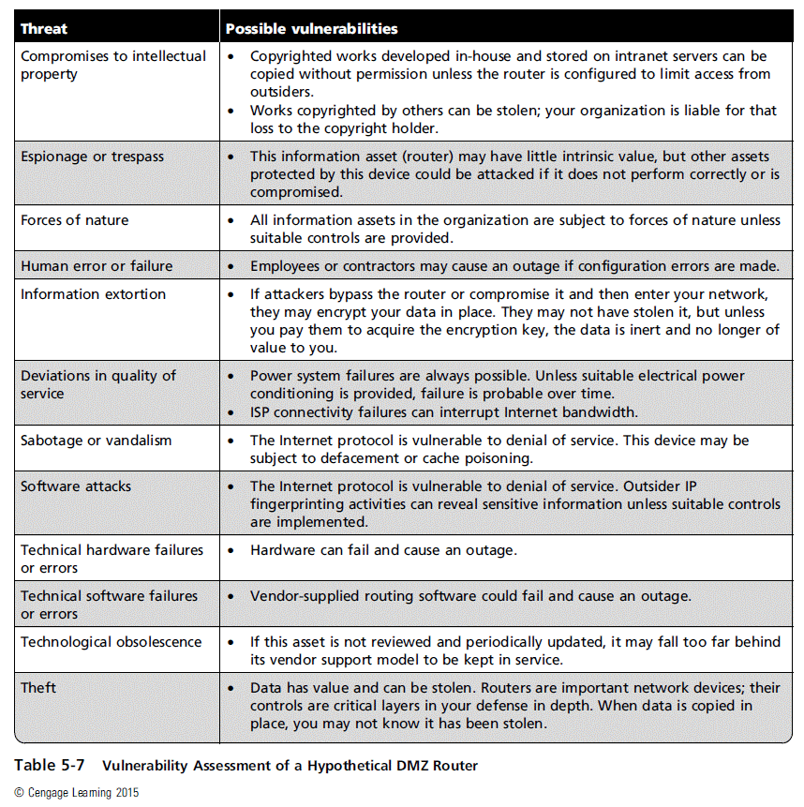
Principles of Information Security, Fifth Edition

Slide 30
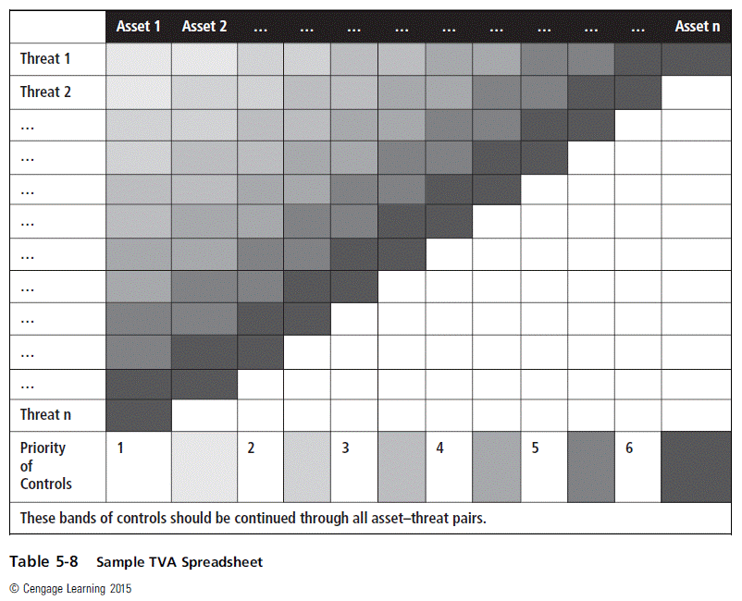
Principles of Information Security, Fifth Edition

Slide 31
Risk Assessment
Risk assessment evaluates the relative risk for each vulnerability.
It assigns a risk rating or score to each information asset.
Planning and organizing risk assessment
  The goal at this point is to create a method for evaluating the relative risk of each listed vulnerability.
Principles of Information Security, Fifth Edition
Notes:
Risk Assessment
Risk assessment evaluates the relative risk for each vulnerability
Assigns a risk rating or score to each information asset
Planning and organizing risk assessment
The goal at this point: create a method for evaluating the relative risk of each listed vulnerability

Slide 32
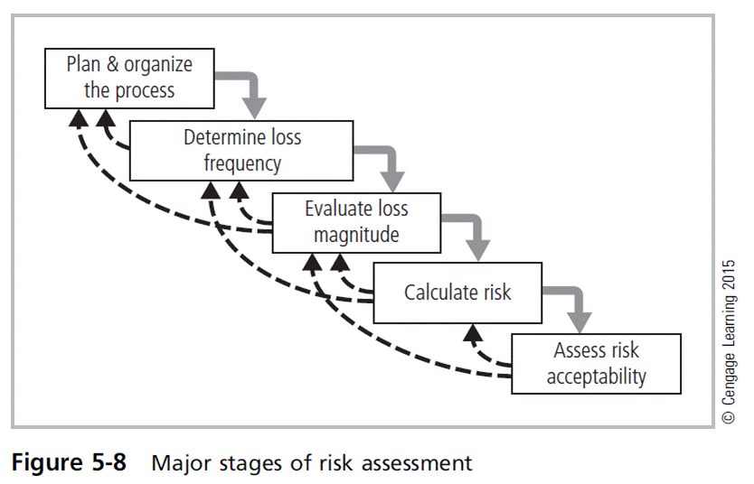
Principles of Information Security, Fifth Edition

Slide 33
Determining the Loss Frequency
Describes an assessment of the likelihood of an attack combined with expected probability of success
Use external references for values that have been reviewed/adjusted for your circumstances.
Assign numeric value to likelihood, typically annual value.
  Targeted by hackers once every five years: 1/5,
  20 percent
Determining an attack’s success probability by estimating quantitative value (e.g., 10 percent) for the likelihood of a successful attack; value subject to uncertainty
Principles of Information Security, Fifth Edition
Notes:
Determining the Loss Frequency
Describes assessment of likelihood of attack combined with expected probability of success
Use external references for values that have been reviewed/adjusted for your circumstances
Assign numeric value to likelihood, typically annual value
Targeted by hackers once every five years: 1/5, 20%
Determining attack success probability by estimating quantitative value (ex. 10%) for likelihood of successful attack; value subject to uncertainty

Slide 34
Evaluating Loss Magnitude
The next step is to determine how much of an information asset could be lost in a successful attack.
  Also known as loss magnitude or asset exposure
Combines the value of information asset with the percentage of asset lost in event of a successful attack
Difficulties involve:
  Valuating an information asset
  Estimating percentage of information asset lost during best-case, worst-case, and most likely scenarios
Principles of Information Security, Fifth Edition
Notes:
Evaluating Loss Magnitude
Next step is to determine how much of an information asset could be lost in successful attack
Also known as loss magnitude or asset exposure
Combines value of information asset with percentage of asset lost in event of successful attack
Difficulties involve:
Valuating an information asset
Estimating percentage of information asset lost during best-case, worst-case, and most likely scenarios

Slide 35
Calculating Risk
For the purpose of relative risk assessment, risk equals:
  Loss frequency TIMES loss magnitude
  MINUS the percentage of risk mitigated by current controls
  PLUS an element of uncertainty
Principles of Information Security, Fifth Edition
Notes:
Risk Determination
For the purpose of relative risk assessment, risk equals:
Loss frequency TIMES loss magnitude
MINUS percentage of risk mitigated by current controls
PLUS an element of uncertainty

Slide 36
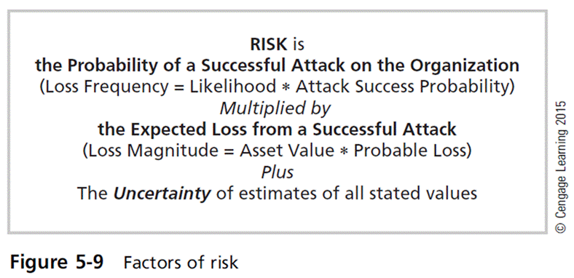
Principles of Information Security, Fifth Edition

Slide 37
Assessing Risk Acceptability
For each threat and associated vulnerabilities that have residual risk, create ranking of relative risk levels.
Residual risk is the left-over risk after the organization has done everything feasible to protect its assets.
If risk appetite is less than the residual risk, it must look for additional strategies to further reduce the risk.
  If risk appetite is greater than the residual risk, it must proceed to the latter stages of risk control.
Principles of Information Security, Fifth Edition
Notes:
Identify Possible Controls
For each threat and associated vulnerabilities that have residual risk, create ranking of relative risk levels
Residual risk is left-over risk after organization has done everything feasible to protect assets
If risk appetite less than residual risk, must look for additional strategies to further reduce the risk
If appetite greater than residual risk, proceed to latter stages of risk control

Slide 38
Documenting the Results of Risk Assessment
The final summarized document is the ranked vulnerability risk worksheet.
Worksheet describes asset, asset relative value, vulnerability, loss frequency, and loss magnitude.
Ranked vulnerability risk worksheet is the initial working document for the next step in the risk management process: assessing and controlling risk.
Principles of Information Security, Fifth Edition
Notes:
Documenting Results of Risk Assessment
The goal of this process has been to identify the information assets of the organization that have specific vulnerabilities and create a list of them, ranked for focus on those most needing protection first.
In preparing this list, we have collected and preserved a wealth of factual information about the assets, the threats they face, and the vulnerabilities they experience.
We should also have collected some information about the controls that are already in place.

Slide 39
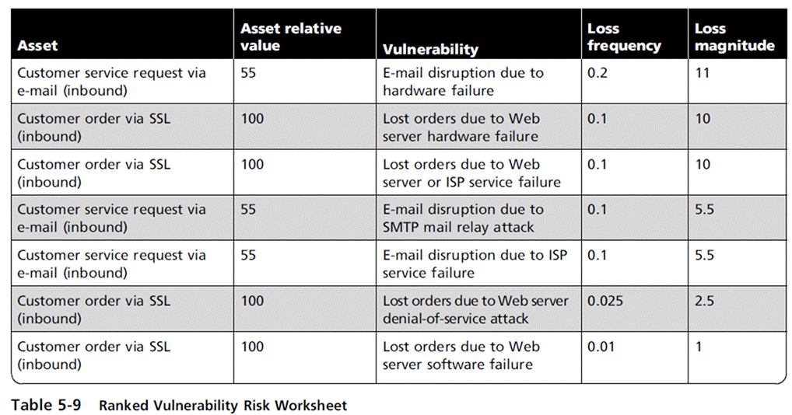
Principles of Information Security, Fifth Edition

Slide 40
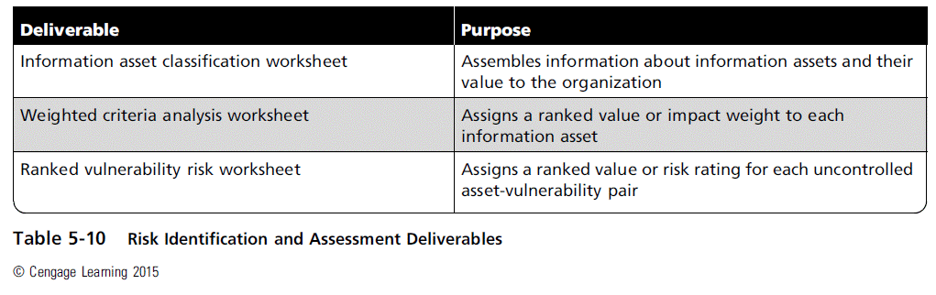
Principles of Information Security, Fifth Edition

Slide 41
The FAIR Approach to Risk Assessment
Identify scenario components
Evaluate loss event frequency
Evaluate probable loss magnitude
Derive and articulate risk
Principles of Information Security, Fifth Edition

Slide 42
Risk Control
Involves selection of control strategies, justification of strategies to upper management, and implementation/monitoring/ongoing assessment of adopted controls
Once the ranked vulnerability risk worksheet is complete, the organization must choose one of five strategies to control each risk:
  Defense
  Transfer
  Mitigation
  Acceptance
  Termination
Principles of Information Security, Fifth Edition
Notes:
Risk Control Strategies
Involves selection of control strategies, justification of strategies to upper management, and implementation/monitoring/ongoing assessment of adopted controls
Once ranked vulnerability risk worksheet complete, must choose one of five strategies to control each risk:
Defense
Transfer
Mitigation
Acceptance
Termination

Slide 43
Defense
Attempts to prevent exploitation of the vulnerability
Preferred approach
Accomplished through countering threats, removing asset vulnerabilities, limiting asset access, and adding protective safeguards
Three common methods of risk avoidance:
  Application of policy
  Education and training
  Applying technology
Principles of Information Security, Fifth Edition
Notes:
Defend
Attempts to prevent exploitation of the vulnerability
Preferred approach
Accomplished through countering threats, removing asset vulnerabilities, limiting asset access, and adding protective safeguards
Three common methods of risk avoidance:
Application of policy
Education and training
Applying technology

Slide 44
Transfer
Attempts to shift risk to other assets, processes, or organizations
If lacking, the organization should hire individuals/firms that provide security management and administration expertise.
The organization may then transfer the risk associated with management of complex systems to another organization experienced in dealing with those risks.
Principles of Information Security, Fifth Edition
Notes:
Transfer
Attempts to shift risk to other assets, processes, or organizations
If lacking, organization should hire individuals/firms that provide security management and administration expertise
Organization may then transfer risk associated with management of complex systems to another organization experienced in dealing with those risks

Slide 45
Mitigate
Attempts to reduce impact of attack rather than reduce success of attack itself
Approach includes three types of plans:
  Incident response (IR) plan: define the actions to take while incident is in progress
  Disaster recovery (DR) plan: the most common mitigation procedure; preparations for the recovery process
  Business continuity (BC) plan: encompasses the continuation of business activities if a catastrophic event occurs
Principles of Information Security, Fifth Edition
Notes:
Mitigation
Attempts to reduce impact of attack rather than reduce success of attack itself
Approach includes three types of plans
Incident response (IR) plan: define the actions to take while incident is in progress
Disaster recovery (DR) plan: most common mitigation procedure; preparations for recovery process
Business continuity (BC) plan: encompasses continuation of business activities if catastrophic event occurs

Slide 46
Acceptance and Termination
Acceptance
  Doing nothing to protect a vulnerability and accepting the outcome of its exploitation
  Valid only when the particular function, service, information, or asset does not justify the cost of protection
Termination
  Directs the organization to avoid business activities that introduce uncontrollable risks
  May seek an alternate mechanism to meet the customer needs
Principles of Information Security, Fifth Edition
Notes:
Acceptance and Termination
Acceptance
Doing nothing to protect a vulnerability and accepting the outcome of its exploitation
Valid only when the particular function, service, information, or asset does not justify cost of protection
Termination
Directs the organization to avoid business activities that introduce uncontrollable risks
May seek an alternate mechanism to meet customer needs

Slide 47
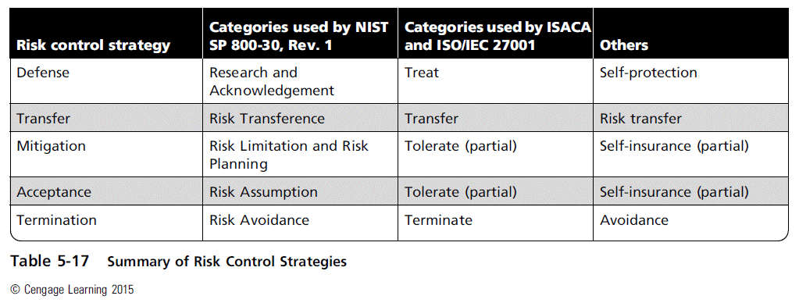
Principles of Information Security, Fifth Edition

Slide 48
Selecting a Risk Control Strategy
Level of threat and value of asset should play a major role in the selection of strategy.
Rules of thumb on strategy selection can be applied:
  When a vulnerability exists
  When a vulnerability can be exploited
  When attacker’s cost is less than the potential gain
  When potential loss is substantial
Principles of Information Security, Fifth Edition
Notes:
Mitigation Strategy Selection
Level of threat and value of asset should play major role in selection of strategy
Rules of thumb on strategy selection can be applied:
When a vulnerability exists
When a vulnerability can be exploited
When attacker’s cost is less than potential gain
When potential loss is substantial

Slide 49
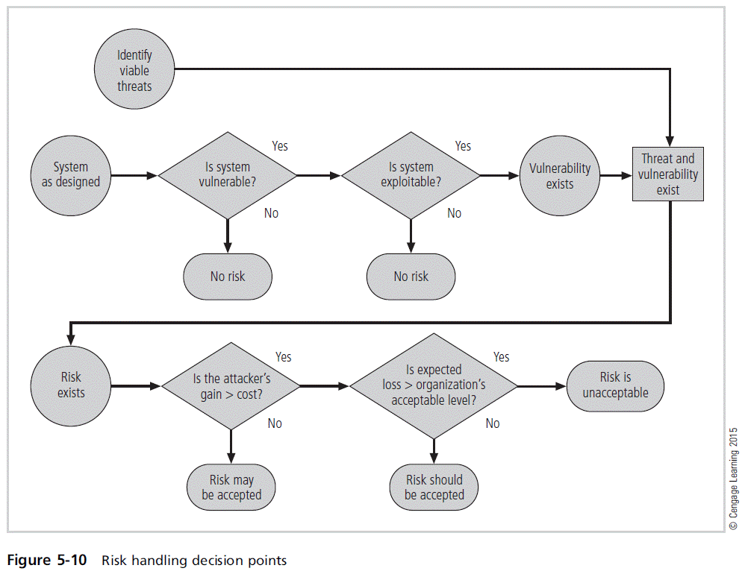
Principles of Information Security, Fifth Edition

Slide 50
Justifying Controls
Before implementing one of the control strategies for a specific vulnerability, the organization must explore all consequences of vulnerability to information asset.
Several ways to determine the advantages/disadvantages of a specific control
Items that affect cost of a control or safeguard include cost of development or acquisition, training fees, implementation cost, service costs, and cost of maintenance.
Principles of Information Security, Fifth Edition
Notes:
Justifying Controls
Before implementing one of the control strategies for a specific vulnerability, organization must explore all consequences of vulnerability to information asset
Several ways to determine advantages/disadvantages of a specific control
Items that affect cost of a control or safeguard include: cost of development or acquisition; training fees; implementation cost; service costs; cost of maintenance

Slide 51
Justifying Controls (cont’d)‏
Asset valuation involves estimating real/perceived costs associated with design, development, installation, maintenance, protection, recovery, and defense against loss/litigation.
Process result is the estimate of potential loss per risk.
Expected loss per risk stated in the following equation:
  Annualized loss expectancy (ALE) =
  single loss expectancy (SLE) ×
  annualized rate of occurrence (ARO)‏
SLE = asset value × exposure factor (EF)‏
Principles of Information Security, Fifth Edition
Notes:
Justifying Controls
Asset valuation involves estimating real/perceived costs associated with design, development, installation, maintenance, protection, recovery, and defense against loss/litigation
Process result is estimate of potential loss per risk
Expected loss per risk stated in the following equation:
Annualized loss expectancy (ALE) =
single loss expectancy (SLE) ×
annualized rate of occurrence (ARO)‏
SLE = asset value × exposure factor (EF)‏

Slide 52
The Cost-Benefit Analysis (CBA) Formula
CBA determines if an alternative being evaluated is worth the cost incurred to control vulnerability.
  The CBA is most easily calculated using the ALE from earlier assessments, before implementation of the proposed control:
    CBA = ALE(prior) – ALE(post) – ACS
  ALE(prior) is the annualized loss expectancy of risk before implementation of control.
  ALE(post) is the estimated ALE based on control being in place for a period of time.
  ACS is the annualized cost of the safeguard.
Principles of Information Security, Fifth Edition
Notes:
CBA: Formula
CBA determines if alternative being evaluated is worth cost incurred to control vulnerability
CBA most easily calculated using ALE from earlier assessments, before implementation of proposed control:
CBA = ALE(prior) – ALE(post) – ACS
ALE(prior) is annualized loss expectancy of risk before implementation of control
ALE(post) is estimated ALE based on control being in place for a period of time
ACS is the annualized cost of the safeguard

Slide 53
Implementation, Monitoring, and Assessment of Risk Controls
The selection of the control strategy is not the end of a process.
Strategy and accompanying controls must be implemented and monitored on ongoing basis to determine effectiveness and accurately calculate the estimated residual risk.
Process continues as long as the organization continues to function.
Principles of Information Security, Fifth Edition
Notes:
Implementation, Monitoring, and Assessment of Risk Controls
Selection of control strategy is not end of process
Strategy and accompanying controls must be implemented and monitored on ongoing basis to determine effectiveness and accurately calculate the estimated residual risk
Process continues as long as organization continues to function

Slide 54
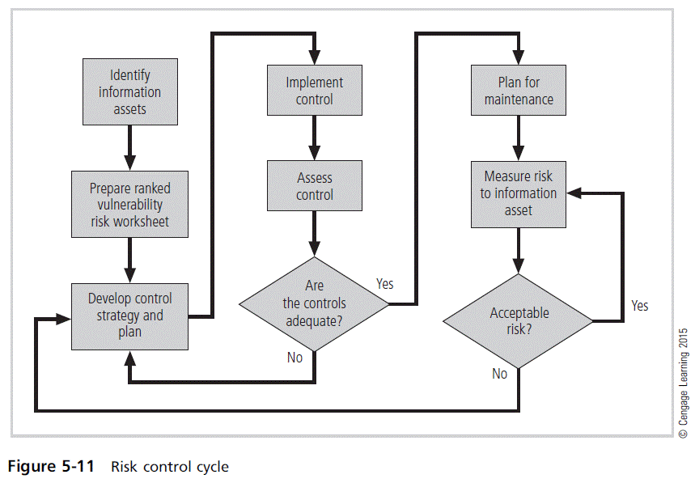
Principles of Information Security, Fifth Edition

Slide 55
Quantitative Versus Qualitative Risk Control Practices
Performing the previous steps using actual values or estimates is known as quantitative assessment.
Possible to complete steps using an evaluation process based on characteristics using nonnumerical measures, called qualitative assessment
Utilizing scales rather than specific estimates relieves the organization from the difficulty of determining exact values.
Principles of Information Security, Fifth Edition
Notes:
Quantitative versus Qualitative Risk Control Practices
Performing the previous steps using actual values or estimates is known as quantitative assessment
Possible to complete steps using evaluation process based on characteristics using nonnumerical measures; called qualitative assessment
Utilizing scales rather than specific estimates relieves organization from difficulty of determining exact values

Slide 56
Benchmarking and Best Practices
An alternative approach to risk management
Benchmarking: process of seeking out and studying practices in other organizations that one’s own organization desires to duplicate
One of two measures typically used to compare practices:
  Metrics-based measures, based on numerical standards
  Process-based measures, more strategic and less focused on numbers
Principles of Information Security, Fifth Edition
Notes:
Benchmarking and Best Practices
An alternative approach to risk management
Benchmarking: process of seeking out and studying practices in other organizations that one’s own organization desires to duplicate
One of two measures typically used to compare practices:
Metrics-based measures; based on numerical standards
Process-based measures; more strategic and less focused on numbers

Slide 57
Benchmarking and Best Practices (cont’d)‏
Standard of due care: when adopting levels of security for a legal defense, the organization shows it has done what any prudent organization would do in similar circumstances.
The application of controls at or above prescribed levels and the maintenance of standards of due care show due diligence on the organization’s part.
Failure to support standard of due care or due diligence can leave the organization open to legal liability.
Principles of Information Security, Fifth Edition
Notes:
Benchmarking/Best Practices cont’d.
Standard of due care: when adopting levels of security for a legal defense, organization shows it has done what any prudent organization would do in similar circumstances
Application of controls at or above prescribed levels and maintenance of standards of due care show due diligence on organization’s part
Failure to support standard of due care or due diligence can leave organization open to legal liability

Slide 58
Benchmarking and Best Practices (cont’d)‏
Best business practices: security efforts that provide a superior level of information protection
When considering best practices for adoption in an organization, consider:
  Does organization resemble identified target organization with best practice?
  Are expendable resources similar?
  Is organization in a similar threat environment?
Principles of Information Security, Fifth Edition
Notes:
Best Business Practices
Best business practices: security efforts that provide a superior level of information protection
When considering best practices for adoption in an organization, consider:
Does organization resemble identified target organization with best practice?
Are expendable resources similar?
Is organization in a similar threat environment?

Slide 59
Benchmarking and Best Practices (cont’d)‏
Problems with the application of benchmarking and best practices
  Organizations don’t talk to each other (biggest problem)‏.
  No two organizations are identical.
  Best practices are a moving target.
  Researching information security benchmarks doesn’t necessarily prepare a practitioner for what to do next.
Principles of Information Security, Fifth Edition
Notes:
Problems with Benchmarking and Best Practices
Problems with the application of benchmarking and best practices
Organizations don’t talk to each other (biggest problem)‏
No two organizations are identical
Best practices are a moving target
Researching information security benchmarks doesn’t necessarily prepare practitioner for what to do next

Slide 60
Benchmarking and Best Practices (cont’d)‏
Baselining
  Performance value or metric used to compare changes in the object being measured.
  In information security, baselining is the comparison of past security activities and events against an organization’s future performance.
  Useful during baselining to have a guide to the overall process
Principles of Information Security, Fifth Edition
Notes:
Baselining
Baselining
Performance value or metric used to compare changes in object being measured
In information security, baselining is comparison of past security activities and events against an organization’s future performance
Useful during baselining to have a guide to the overall process

Slide 61
Other Feasibility Studies
Organizational: Assesses how well the proposed IS alternatives will contribute to an organization’s efficiency, effectiveness, and overall operation
Operational: Assesses user and management acceptance and support, and the overall requirements of the organization’s stakeholders
Technical: Assesses if organization has or can acquire the technology necessary to implement and support proposed control
Political: Defines what can/cannot occur based on the consensus and relationships among communities of interest
Principles of Information Security, Fifth Edition
Notes:
Organizational Feasibility
Organizational: assesses how well proposed IS alternatives will contribute to organization’s efficiency, effectiveness, and overall operation
Operational: assesses user and management acceptance and support, and the overall requirements of the organization’s stakeholders
Technical: assesses if organization has or can acquire the technology necessary to implement and support proposed control
Political: defines what can/cannot occur based on consensus and relationships among communities of interest

Slide 62
Recommended Risk Control Practices
Convince budget authorities to spend up to value of asset to protect from identified threat.
Chosen controls may be a balanced mixture that provides greatest value to as many asset-threat pairs as possible.
Organizations looking to implement controls that don’t involve such complex, inexact, and dynamic calculations.
Principles of Information Security, Fifth Edition
Notes:
Recommended Practices in Controlling Risk
Convince budget authorities to spend up to value of asset to protect from identified threat
Chosen controls may be a balanced mixture that provides greatest value to as many asset-threat pairs as possible
Organizations looking to implement controls that don’t involve such complex, inexact, and dynamic calculations

Slide 63
Documenting Results
At minimum, each information asset-threat pair should have documented control strategy clearly identifying any remaining residual risk.
Another option: Document the outcome of the control strategy for each information asset-vulnerability pair as an action plan.
Risk assessment may be documented in a topic-specific report.
Principles of Information Security, Fifth Edition
Notes:
Documenting Results
At minimum, each information asset-threat pair should have documented control strategy clearly identifying any remaining residual risk
Another option: document outcome of control strategy for each information asset-vulnerability pair as an action plan
Risk assessment may be documented in a topic-specific report

Slide 64
The NIST Risk Management Framework
Describes risk management as a comprehensive process requiring organizations to:
  Frame risk
  Assess risk
  Respond to determined risk
  Monitor risk on ongoing basis
Principles of Information Security, Fifth Edition
Notes:
NIST Risk Management Framework
Describes risk management as comprehensive process requiring organizations to
Frame risk
Assess risk
Respond to determined risk
Monitor risk on ongoing basis

Slide 65
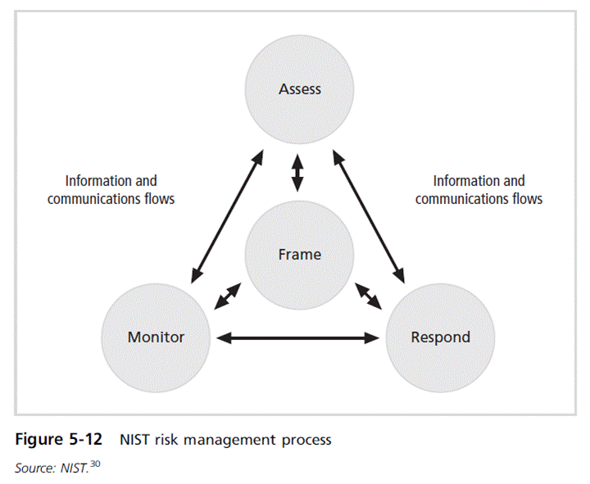
Principles of Information Security, Fifth Edition

Slide 66
Summary
Risk identification: formal process of examining and documenting risk in information systems
Risk control: process of taking carefully reasoned steps to ensure the confidentiality, integrity, and availability of the components of an information system
Risk identification
  A risk management strategy enables identification, classification, and prioritization of organization’s information assets.
  Residual risk: risk remaining to the information asset even after the existing control is applied
Principles of Information Security, Fifth Edition
Notes:
Summary
Risk identification: formal process of examining and documenting risk in information systems
Risk control: process of taking carefully reasoned steps to ensure the confidentiality, integrity, and availability of components of an information system
Risk identification
A risk management strategy enables identification, classification, and prioritization of organization’s information assets
Residual risk: risk remaining to the information asset even after the existing control is applied

Slide 67
Summary (cont’d)
Risk control: Five strategies are used to control risks that result from vulnerabilities:
  Defend
  Transfer
  Mitigate
  Accept
  Terminate
Principles of Information Security, Fifth Edition
Notes:
Summary
Risk control: five strategies are used to control risks that result from vulnerabilities:
Defend
Transfer
Mitigate
Accept
Terminate

